Slide 1
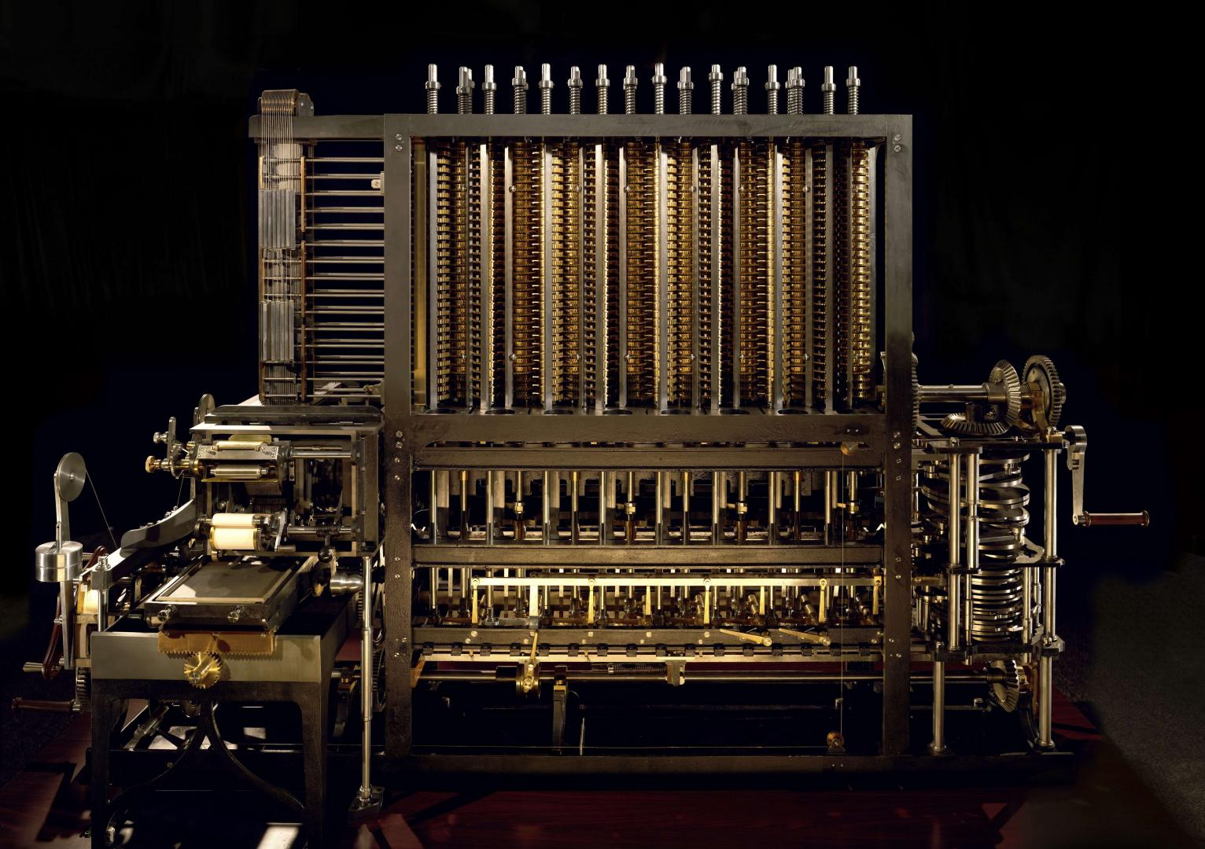
Hands-on digital humanities
Collections and Heritage: Challenges and Futures
Mark Bell and Jo Pugh
23rd February 2018

Slide 2
Plan
12-12.30pm Introduction: principles and tools
12.30pm Lunch
1.15pm
  Georeferencing in Fusion Tables
  Topic Modelling in Mallet
3pm Coffee break
3.15pm Feedback and discussion

Slide 3
“Computers have no inbuilt prejudice favouring science; indeed, they crunch numbers which deal with the fluctuations of sun spots as happily as those describing the income of medieval landlords.”
− Manfred Thaller (1987)
'Methods and Techniques of Historical Computation' in Denley and Hopkin (ed). 'History and Computing, Manchester University Press (1987), p.147

Slide 4
What is digital humanities?

Slide 5
What is digital humanities?
Hit F5 until your finger falls off
https://whatisdigitalhumanities.com/

Slide 6
What is digital humanities?
Elijah Meeks (Columbia, Netflix) has said that digital humanities has 3(+1) ‘pillars’:
Georeferencing and GIS
Text processing
Network analysis
+ Visualisation
https://dhs.stanford.edu/algorithmic-literacy/digital-literacy-and-digital-citizenship/

Slide 7
Lunch
Check you can log into a Google account to access http://google.fusiontables.com
Visit http://mallet.cs.umass.edu/download.php to download and install Mallet
Download OpenRefine from http://openrefine.org/download.html
Useful resources at:
https://github.com/mentionthewar/Collections-and-Heritage

Slide 8
Introducing the data
COPY 1
Museum Futures

Slide 9
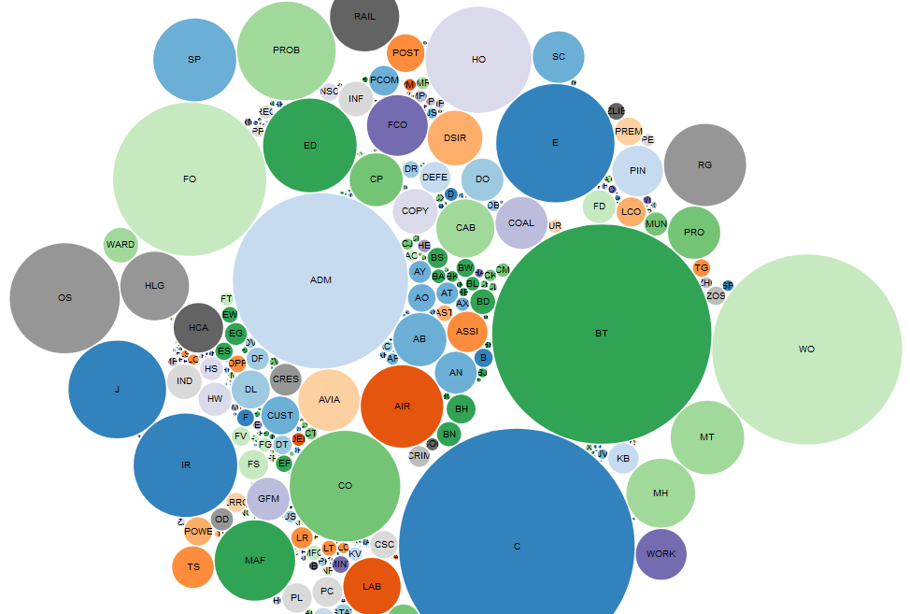
The National Archives

Slide 10
Museum Futures
http://museum-id.com/the-futuremuseum-project-what-will-museums-be-like-in-the-future-essay-collection/
Museum ID project in 2012.

Slide 11
Unleash the algorithm!

Slide 12
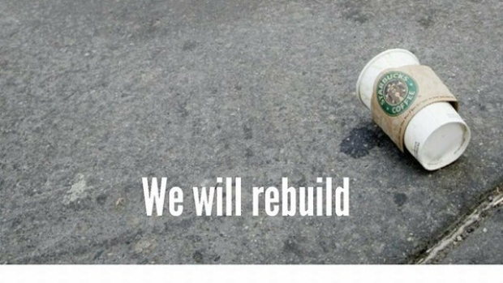

Slide 13
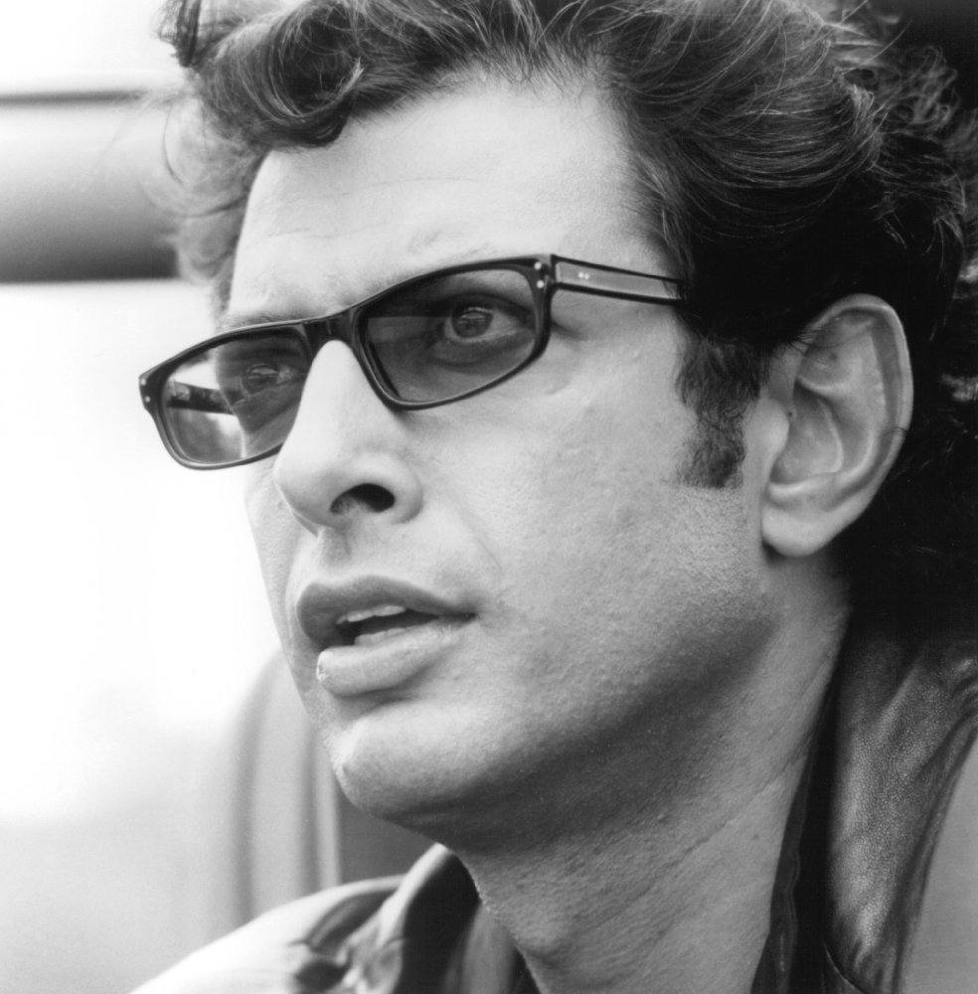
“Your scientists were so preoccupied with whether they could that they didn’t stop to think if they should.”
– Dr Ian Malcolm

